Slide 1
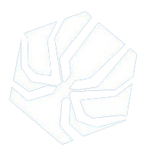
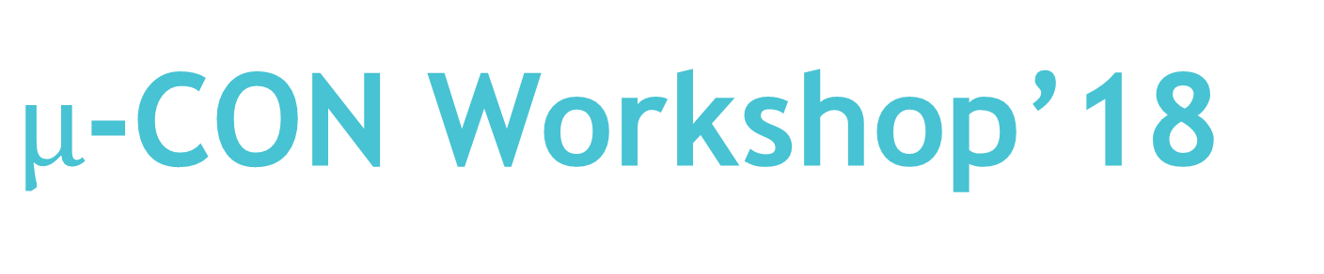
$µ$-CON Workshop’18
“ Wireless Game Controller
Using Infrared Data Transmission ”

Slide 2
Session 1: Basic of Electronics
28th Sep’18, 17:00 to 20:00 Hrs.

Slide 3
Before Starting :
Lets first go through these three devices / components
1. Breadboard
2. Multimeter
3. PCBs

Slide 4
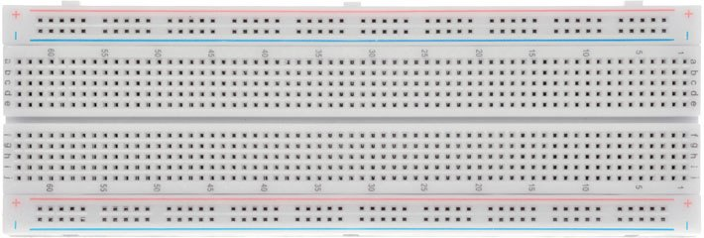
Breadboard:
A breadboard is a solderless device for temporary prototype with electronics and test circuit designs.

Slide 5
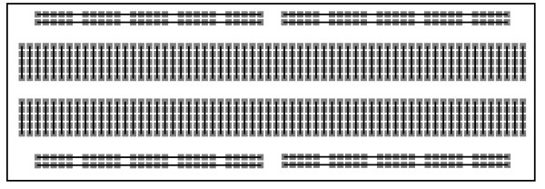
BREADBOARD INTERNAL CONNECTIONS
All the squares/holes connected via a black line are on the same potential level, i.e. they are
on the same node or are internally connected.
NOTE: We will look for the breadboard connection in detail with each components ahead.

Slide 6
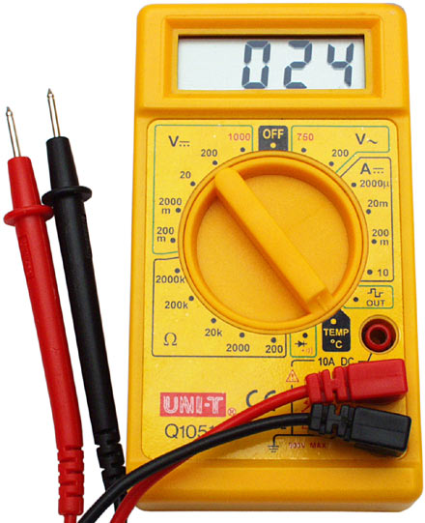
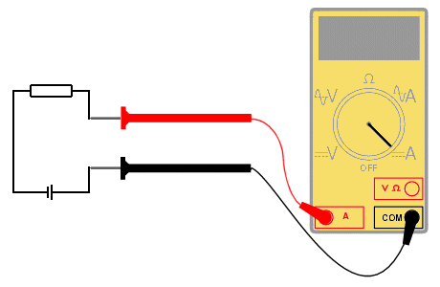
Multimeter:
It is an electronic measuring instrument that combines several measurement functions in one unit.
It can measure Voltage, Current, Resistance.
Can be also used as continuity tester, and temperature sensor

Slide 7
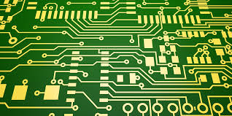
PCBs:
Stands for Printed Circuit Board.
Supports electronic connections via conductive tracks, pads, etched from one or more sheets of copper.
The copper sheets are laminated onto and/or between non-conductive substrate.
Components are generally soldered onto the PCBs.
Soldering establishes both electrical as well as mechanical connection.

Slide 8
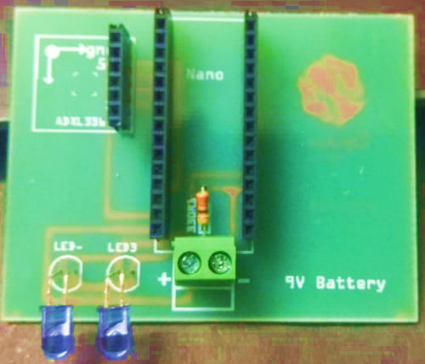
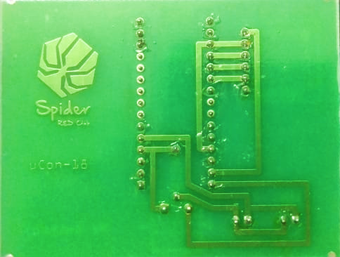
PCBs(Contd..):

Slide 9
Basic Electrical Components
Active Components
Transistors
Diodes
IC’s
Passive Components
Resistors
Capacitors
Inductors

Slide 10
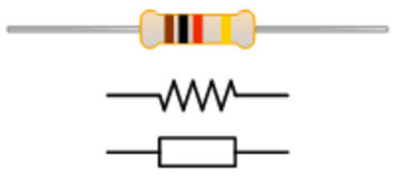
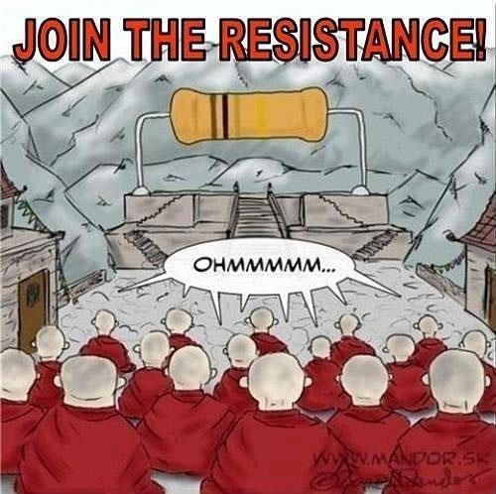
Resistors:
Purpose
- Limit Current
- Voltage Dividing
Composition
- Carbon
Color Code: BBROYGBVGW
How to remember?
ANS: BBROY of Great Britain have a Very Good Wife

Slide 11
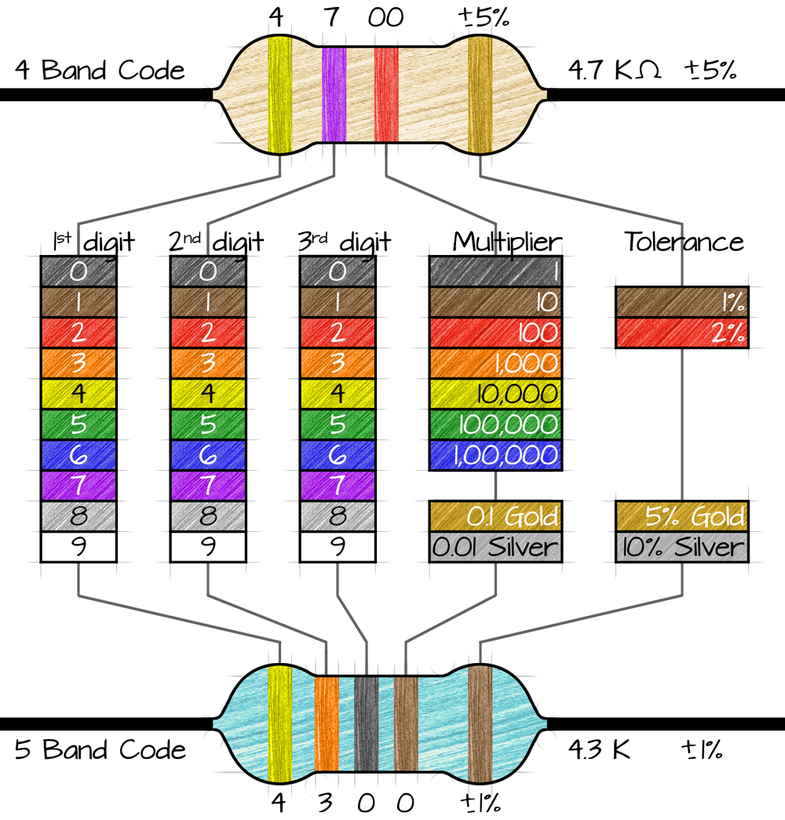
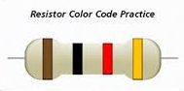
Color Coding of Resistors:
Q: Resistance (in ohms) ?
ANS: 10x10² ± 5%

Slide 12
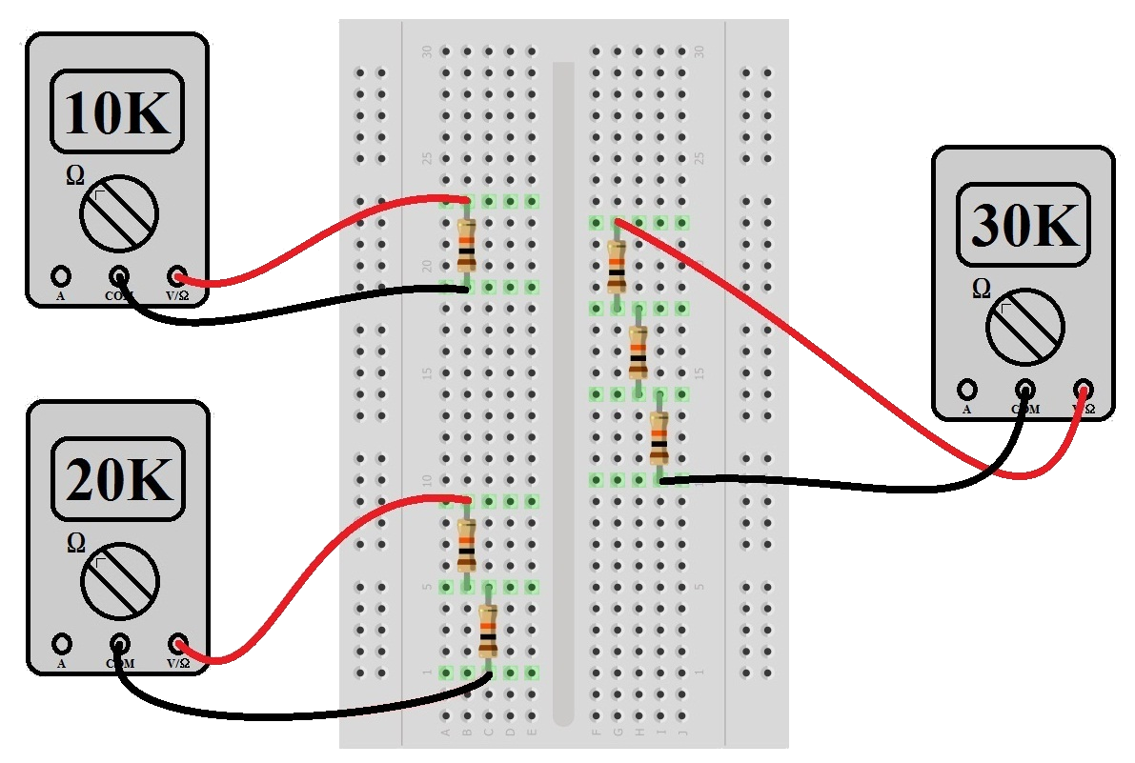
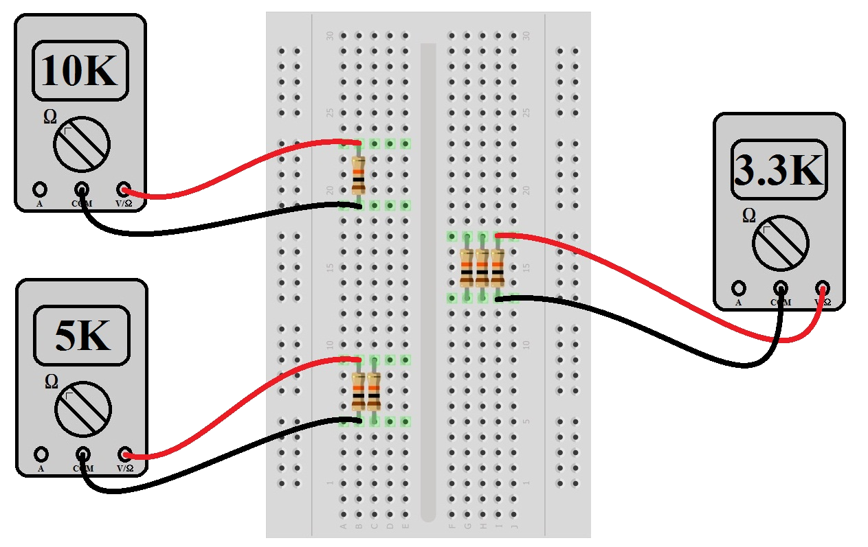
Resistors on Breadboard:
Series
Parallel

Slide 13
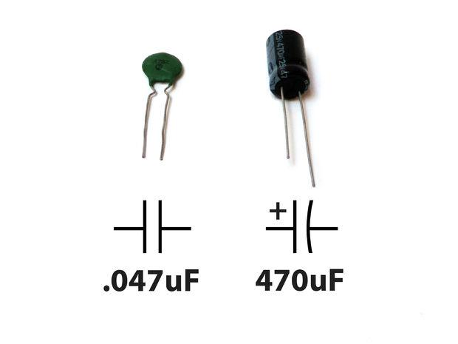
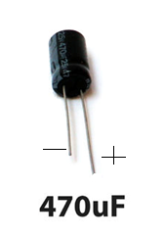
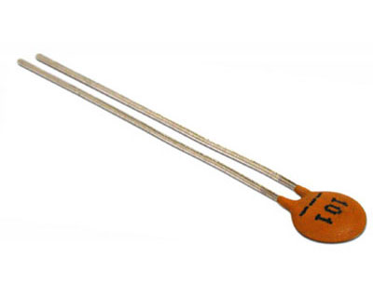

Capacitors:
Purpose
- Stores Charge
- Block D.C Current
- Opposes change in voltage ( $\frac{ⅆV}{ⅆt}$ )
Composition
- Di-Electric material
Types
- Electrolytic (High Capacitance)
- Ceramic (Low Capacitaance)

Slide 14
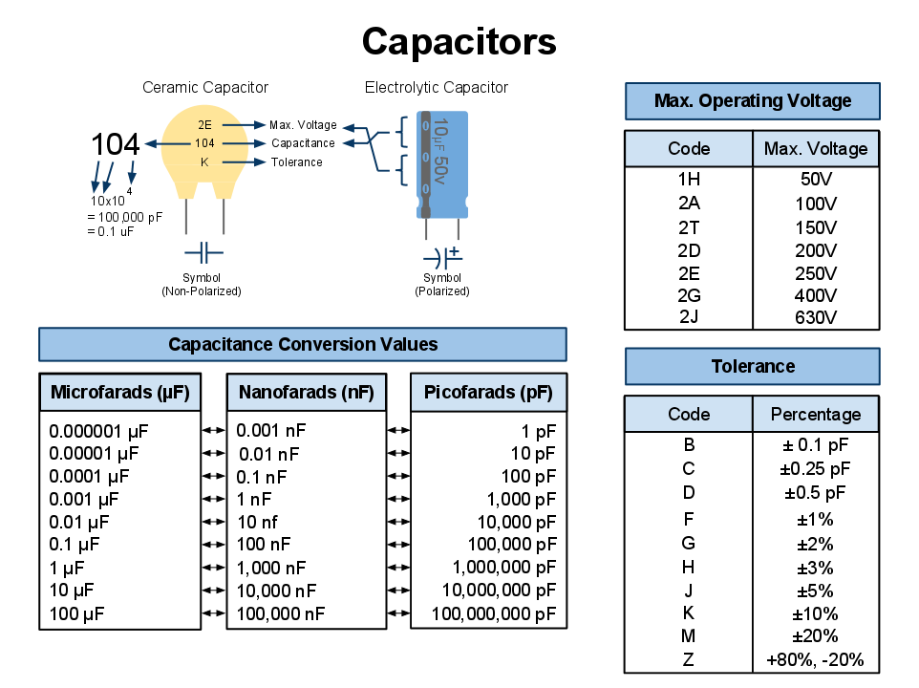

Slide 15
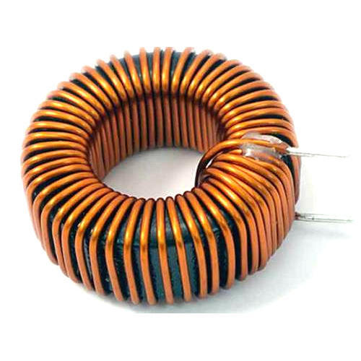
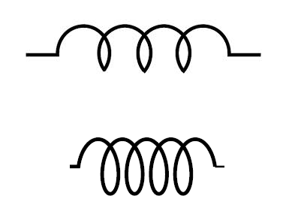
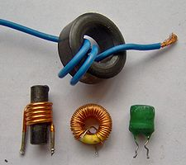
Inductors:
Purpose
- Opposes change in current
- Stores energy in the form of
magnetic energy

Slide 16
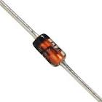
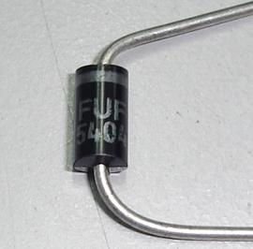
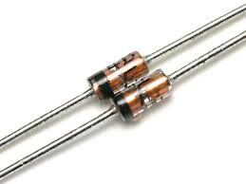
Diodes:
-Blocks current in one direction (switch)
-Unilateral Element
-Conducts only during Forward Biasing
-Composition: Semiconductor material
Some of the common example of diodes-
1. LED
2. Zener Diodes
3. PhotoDiodes

Slide 17
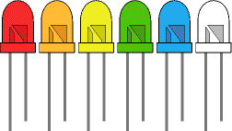
Light Emitting Diodes(LEDs):
Emits a specific wavelength of light depending upon the type of semiconductor material used
Used for indication/debugging in circuits
Q. Identify the positive and negative terminals
Ans: Cut at the annode
or
Longer Terminal -> +ve
Shorter Terminal -> -ve

Slide 18
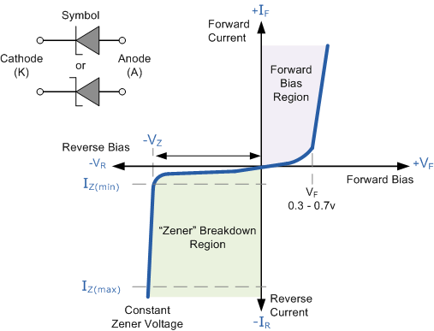
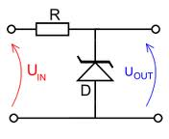
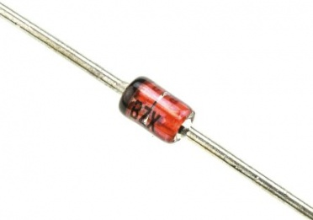
Zener Diodes:
Operates in reverse biased mode.
A constant output voltage is obtained due to Zener Breakdown Mechanism.

Slide 19
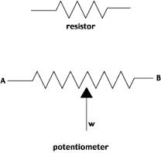
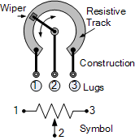
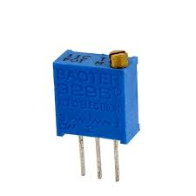
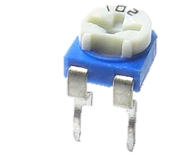
Potentiometer:
Also known as Pot/Variable Resistor.
Resistance varies on turning the adjustable knob.
Output is taped from the centre pin
Q. What is the main difference between a Rheostat and Potentiometer ?

Slide 20
Difference between Rheostat and Potentiometer
RHEOSTAT
POTENTIOMETER
A rheostat is a variable resistor with two terminals.
A Rheostat is used to vary the amount of current in the circuit
A potentiometer is a resistor with three terminals and a sliding contact with an adjustable voltage divider
A potentiometer used to vary the voltage between the second terminal and one of the outside terminal

Slide 21
LET’S THINK FOR A MOMENT :
Imagine this..
You see on the main roads there are numerous number of street lights, and there is no watchman to turn it ON/OFF. But it automatically gets turned ON during evening and OFF in the morning. How does that happen? Which electronic device is used there ?
HINT: See what actually differs in Day as compared to Night.
This question leads us to our next electronic device…

Slide 22
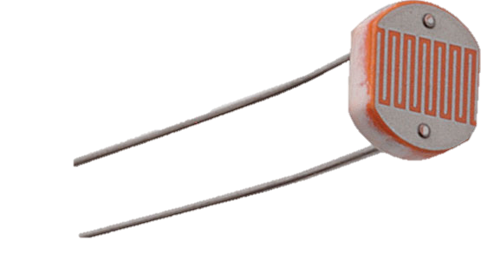
LDR (Light Dependent Resistors):
Composed of Cadmium Sulphide(CdS)
LDRs can respond to change in light intensity by the variation of resistance across its terminals.
Increase in light intensity results in increase in concentration of charge carriers, which in turn increases the conductivity and hence Resistance decreases.

Slide 23
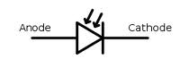
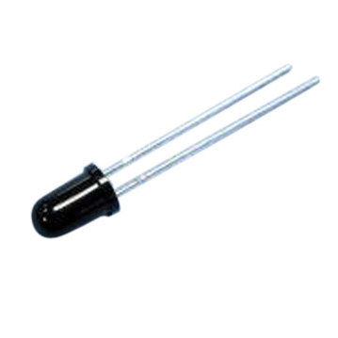
Photo Diodes:
Connected in reverse biased configuration
Most sensitive to IR. ( IR Detector)
Considered as Light Dependent Resistor.
Disadvantage of LDR: More sensitive to ambient light.

Slide 24
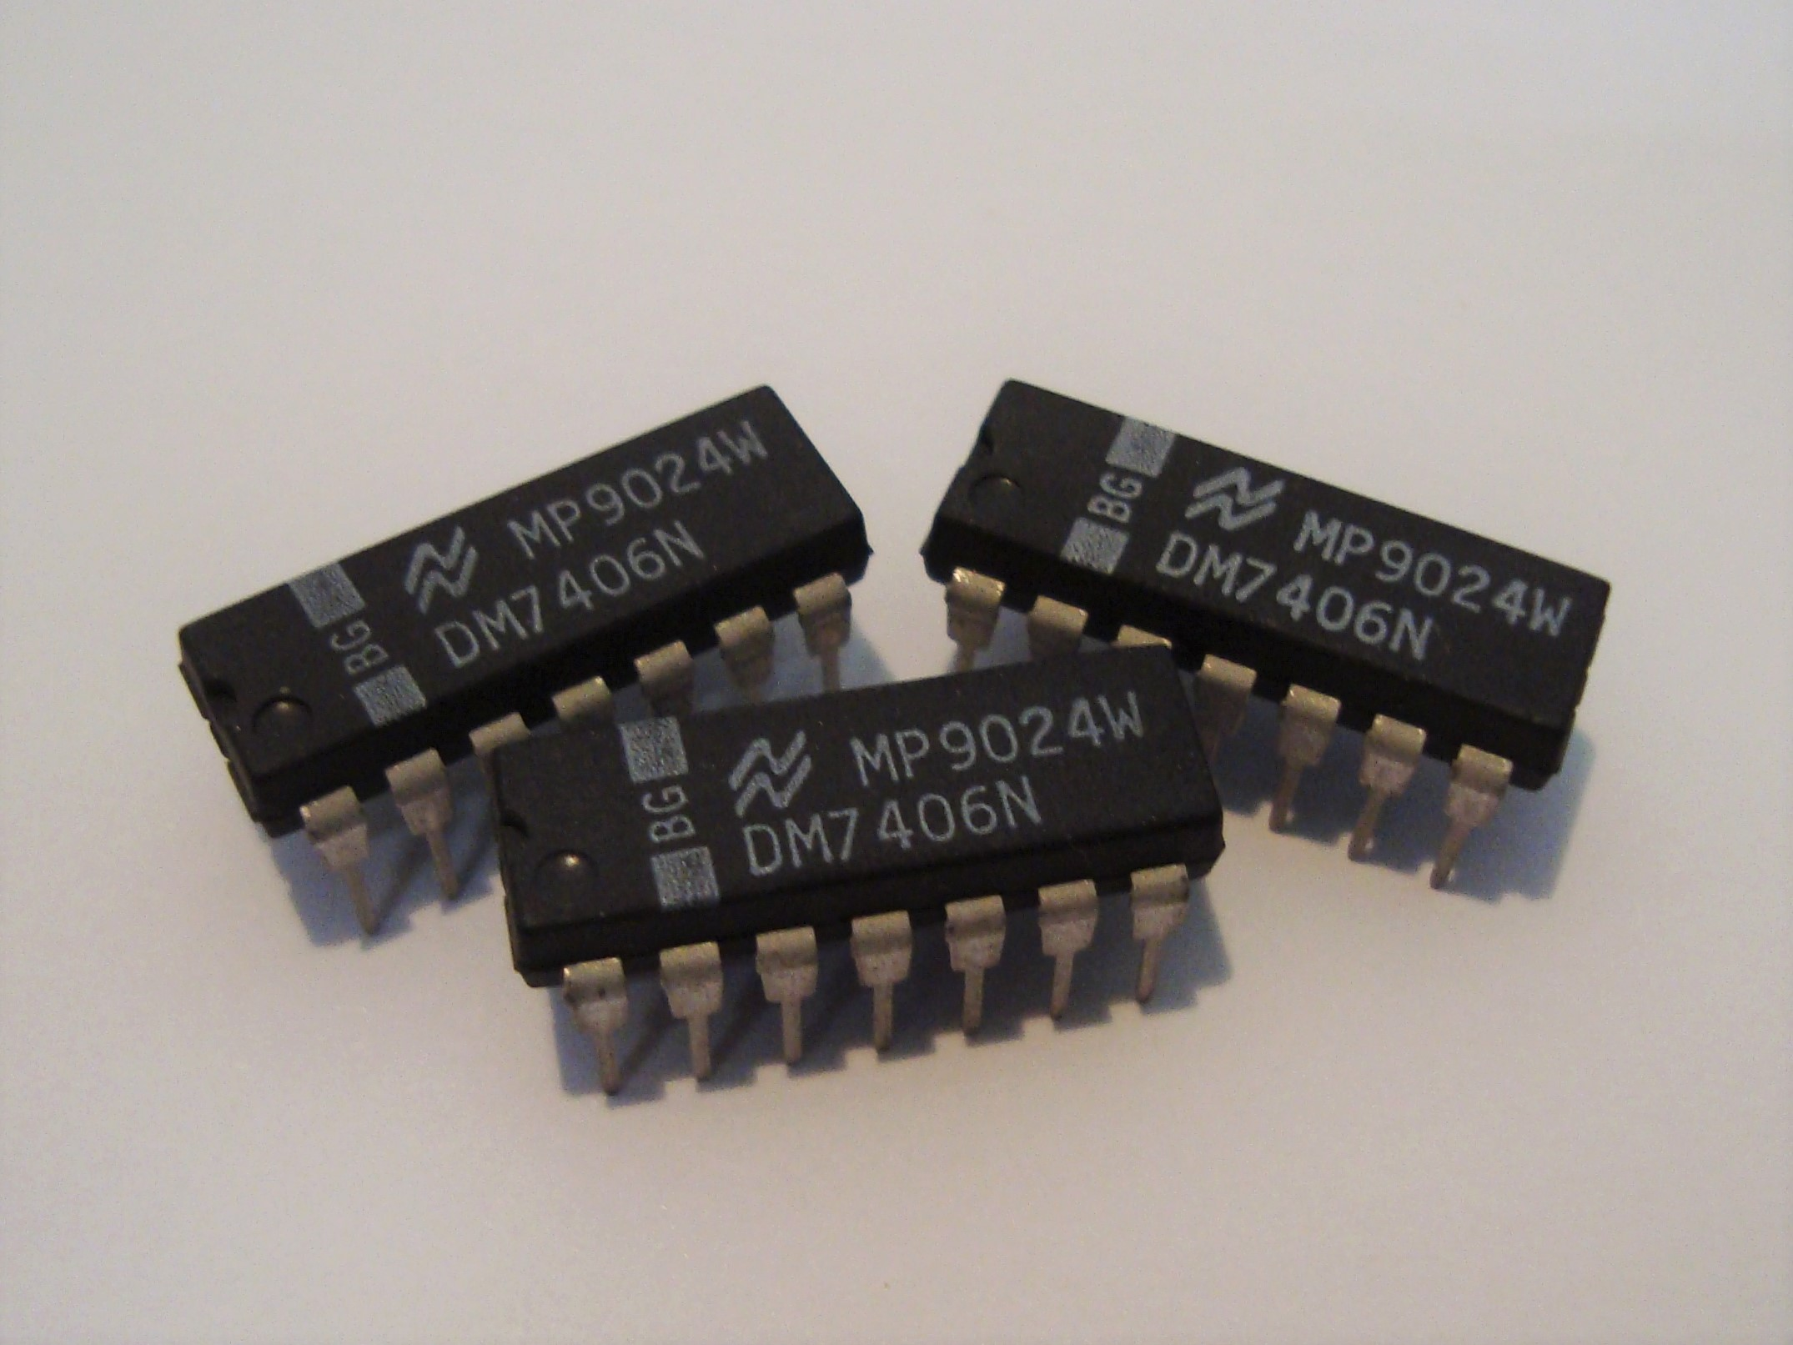
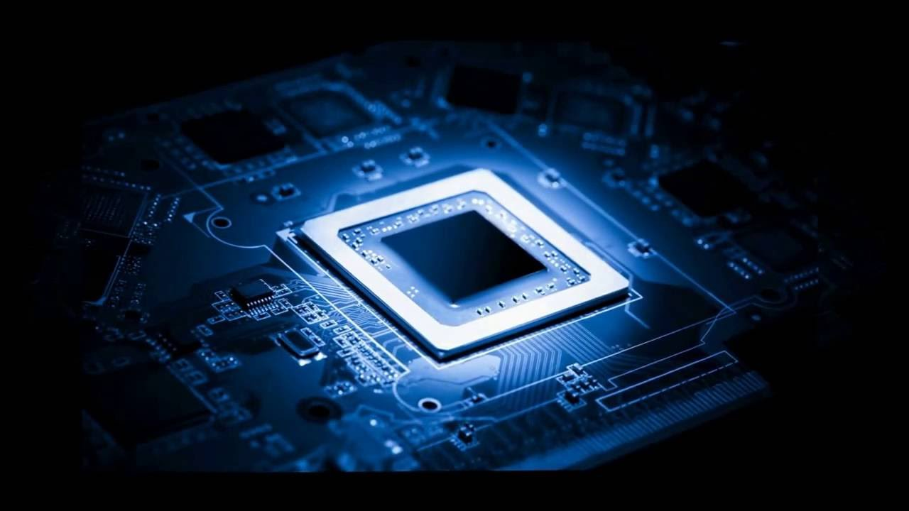
Integrated Circuits (ICs):
These are basically electronic circuits on a piece of semiconductor material.
Types :-
1. SSI ( Small Scale Integration )
2. MSI ( Medium Scale Integration )
3. LSI ( Large Scale Integration )
4. VLSI ( Very Large Scale Integration )
They come in various shape and sizes.

Slide 25

LET’S THINK FOR A MOMENT AGAIN :
Our electronic circuit requires a 5 V supply to run. Anything above 5V damages our device.
But, we are left with only a 9V battery. What do we do?

Slide 26
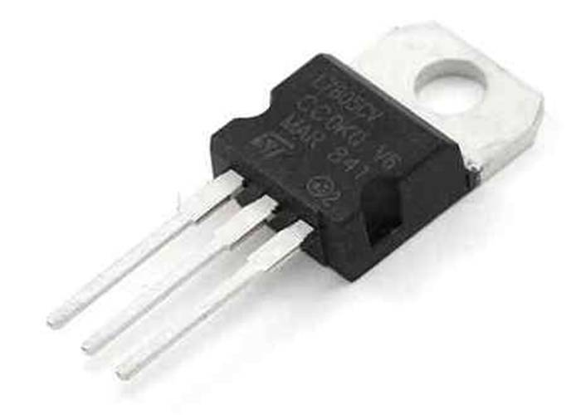
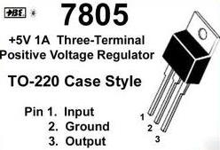
Voltage Regulators (78xx Series):
A constant regulated voltage is obtained from a higher input voltage.
E.g. 7805 gives 5V as output as long as input is between 7V and 35V
The XX denotes the output voltage, for instance 7805 gives 5V, 7812 gives 12V etc.

Slide 27
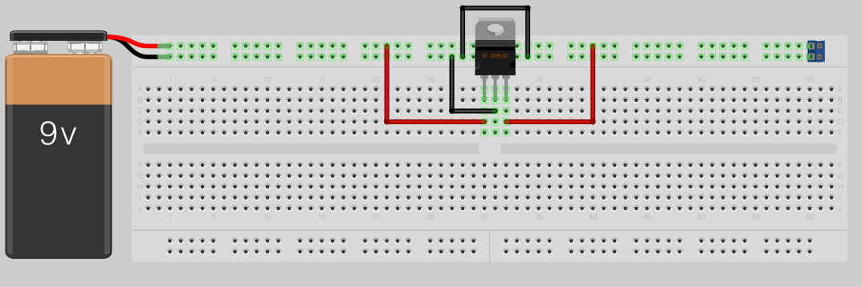
Breadboard Connection:
+5V

Slide 28
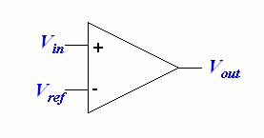
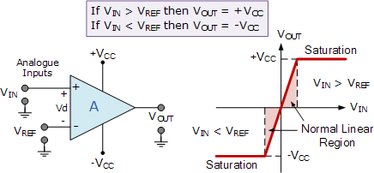
Operational Amplifier (Op-amp) as Comparator:
Compares the two input values and gives a high or low as output depending upon which input is higher.
One input is given as constant value (Reference V)
If the given signal has high voltage than the Ref. then output is HIGH, else in the other case its LOW.

Slide 29
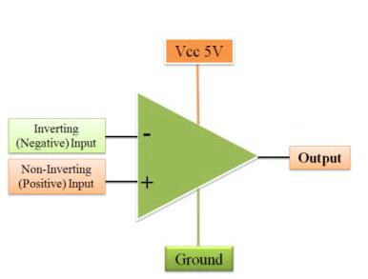
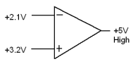
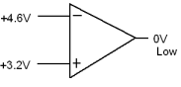
Properties of Comparator:
- If V₊ > V₋ then V_{o}=V_{cc}
(Digital High 1 output)
- If V₊ < V₋ then V_{o}=0
(Digital Low 0 output)

Slide 30
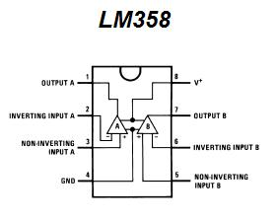
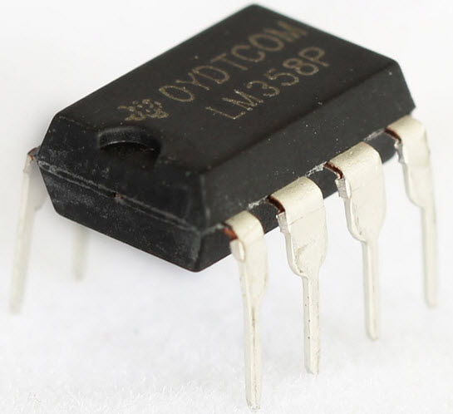
LM358 IC:
Op-amp IC.
Dual Comparator, i.e. has two op-amps that can act as comparator inside the casing.

Slide 31
TODAYS MAIN TASK
“Square Wave Generation using op-amp”

Slide 32

SQUARE WAVE GENERATOR USING OPAMP
Also known as astable multivibrator
Same as SCHIMIT TRIGGER circuit in which ref. voltage is given from the output.
Output:

Slide 33
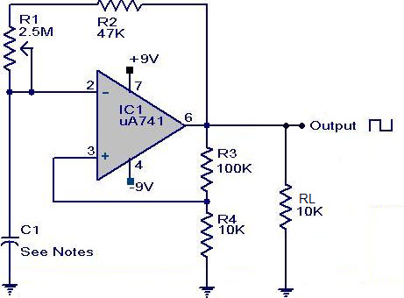
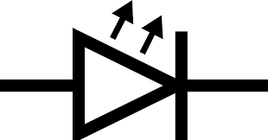

SQUARE WAVE GENERATOR USING OPAMP
1 M
8
LED 1
1
R4
330
LM358
LED 2

Slide 34

SQUARE WAVE GENERATOR USING OPAMP

Slide 35

SQUARE WAVE GENERATOR USING OPAMP

Slide 36
Thank You

